Slide 1
7 Tools Every Python Developer Should Know

Slide 2

More and more tools…
poetry, interrogate, setuptools, pyenv, virtualenv, black, ruff, isort, flake8, pylint, pre-commit, pipreqs, sphinx, nox, twine, pip, safety, darglint, docformatter, pydoctor, bandit, pip-autoremove, miniconda, hatch, pyflakes, pdm, pipenv, autopep8, pytype, commitizen, pyright, tox, makefile, pdoc, vulture, yapf, autoflake, blacken-docs, conda, pyflow, mypy, flit, pip-audit, justfile, pycodestyle, pipx, mamba, blue, mkdocs, talisman, tryceratops, …

Slide 3
Focusing on the basics
Python Version Management
Dependency Management
Linting
Formatting
Type Checking
Documentation
Automation

Slide 4

Python Version Management: Pyenv
Project A
Project B
Project C
Python 3.4
Python 3.7
Python 3.10
Notes:
Installation: https://github.com/pyenv/pyenv?tab=readme-ov-file#installation
(If you are a Linux/WSL2 user, you probably also have to look at https://github.com/pyenv/pyenv?tab=readme-ov-file#set-up-your-shell-environment-for-pyenv)
Usage: https://github.com/pyenv/pyenv?tab=readme-ov-file#usage
For Windows Users: https://github.com/pyenv-win/pyenv-win

Slide 5
Python Version Management: Pyenv
Project A
Project B
Project C
Python 3.4
Python 3.7
Python 3.10
→ Every project has its own Python version
→ Switch between versions easily
Notes:
Installation: https://github.com/pyenv/pyenv?tab=readme-ov-file#installation
(If you are a Linux/WSL2 user, you probably also have to look at https://github.com/pyenv/pyenv?tab=readme-ov-file#set-up-your-shell-environment-for-pyenv)
Usage: https://github.com/pyenv/pyenv?tab=readme-ov-file#usage
For Windows Users: https://github.com/pyenv-win/pyenv-win

Slide 6
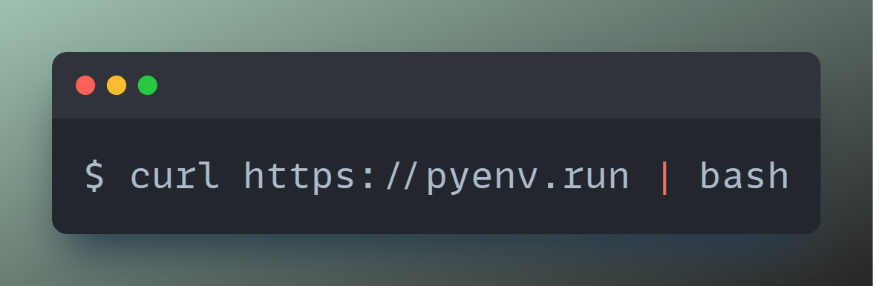
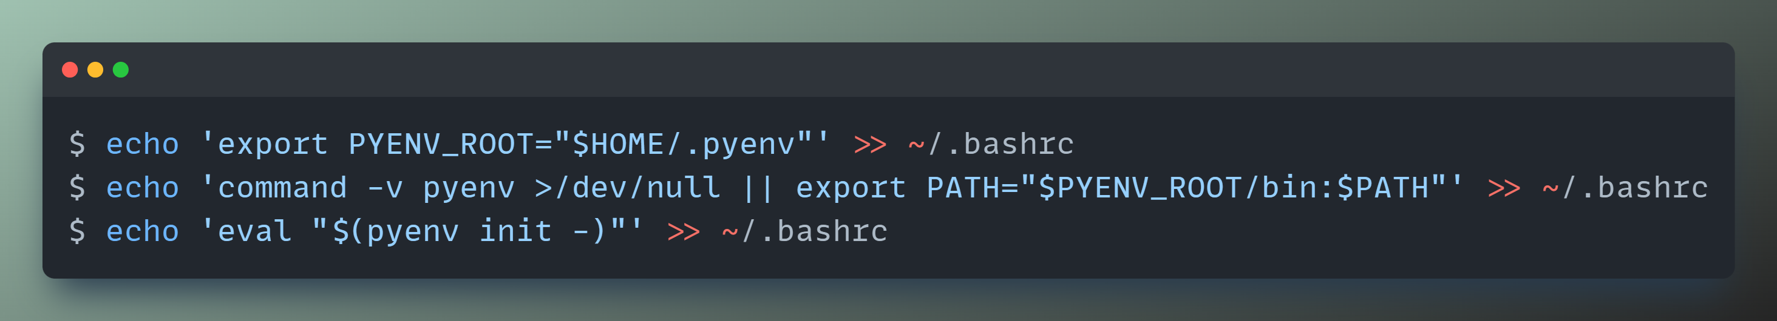
Python Version Management: Pyenv
1. Install Pyenv
2. Set up shell environment for Pyenv
Notes:
Installation: https://github.com/pyenv/pyenv?tab=readme-ov-file#installation
(If you are a Linux/WSL2 user, you probably also have to look at https://github.com/pyenv/pyenv?tab=readme-ov-file#set-up-your-shell-environment-for-pyenv)
Usage: https://github.com/pyenv/pyenv?tab=readme-ov-file#usage
For Windows Users: https://github.com/pyenv-win/pyenv-win

Slide 7
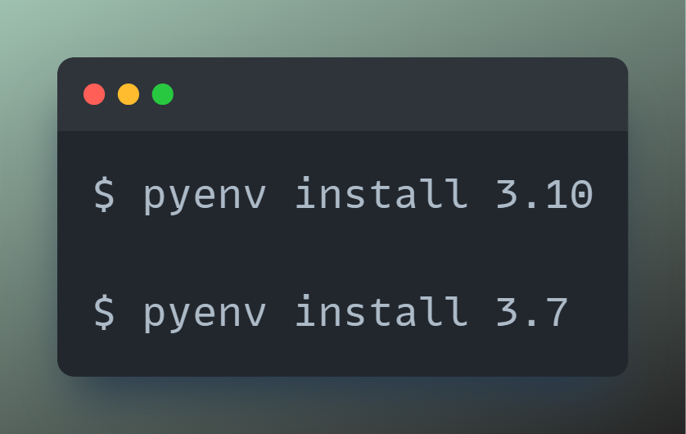
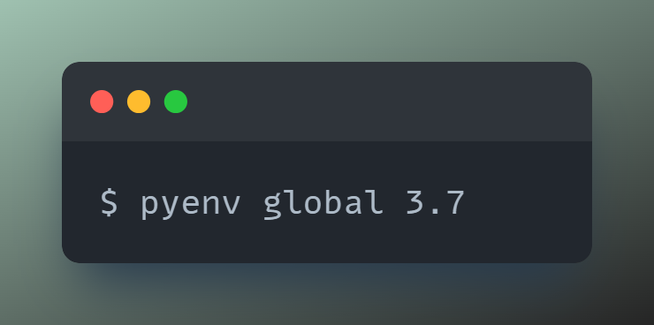
Python Version Management: Pyenv
3. Install Python versions
4. Set global Python version
Notes:
Installation: https://github.com/pyenv/pyenv?tab=readme-ov-file#installation
(If you are a Linux/WSL2 user, you probably also have to look at https://github.com/pyenv/pyenv?tab=readme-ov-file#set-up-your-shell-environment-for-pyenv)
Usage: https://github.com/pyenv/pyenv?tab=readme-ov-file#usage
For Windows Users: https://github.com/pyenv-win/pyenv-win

Slide 8
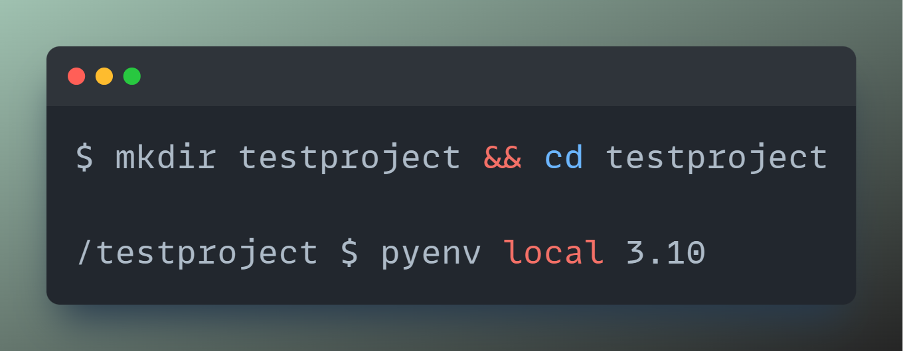
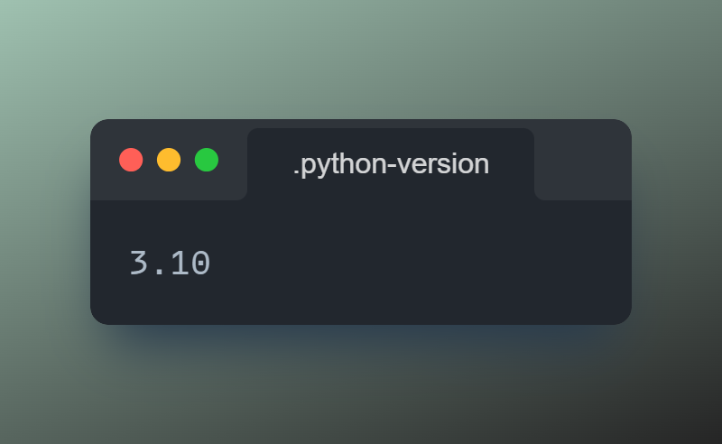
Python Version Management: Pyenv
5. Set local Python version
Notes:
Installation: https://github.com/pyenv/pyenv?tab=readme-ov-file#installation
(If you are a Linux/WSL2 user, you probably also have to look at https://github.com/pyenv/pyenv?tab=readme-ov-file#set-up-your-shell-environment-for-pyenv)
Usage: https://github.com/pyenv/pyenv?tab=readme-ov-file#usage
For Windows Users: https://github.com/pyenv-win/pyenv-win

Slide 9
Dependency Management: Poetry
Project A
Project B
Project C
Pandas 0.13
Pandas 1.0
Pandas 2.0
Notes:
Installation: https://python-poetry.org/docs/#installing-with-the-official-installer
→ I recommend using the official installer instead of installing it via pip (or similar). It‘s much more stable in my experience.
Usage: https://python-poetry.org/docs/basic-usage/
Publish Package to PyPI: https://www.freecodecamp.org/news/how-to-build-and-publish-python-packages-with-poetry/

Slide 10

Dependency Management: Poetry
Notes:
Installation: https://python-poetry.org/docs/#installing-with-the-official-installer
→ I recommend using the official installer instead of installing it via pip (or similar). It‘s much more stable in my experience.
Usage: https://python-poetry.org/docs/basic-usage/
Publish Package to PyPI: https://www.freecodecamp.org/news/how-to-build-and-publish-python-packages-with-poetry/

Slide 11
Dependency Management: Poetry
Project A
Project B
Project C
Pandas 0.10
Pandas 1.0
Pandas 2.0
Every project has its own virtual environment
No dependency conflicts
Notes:
Installation: https://python-poetry.org/docs/#installing-with-the-official-installer
→ I recommend using the official installer instead of installing it via pip (or similar). It‘s much more stable in my experience.
Usage: https://python-poetry.org/docs/basic-usage/
Publish Package to PyPI: https://www.freecodecamp.org/news/how-to-build-and-publish-python-packages-with-poetry/

Slide 12
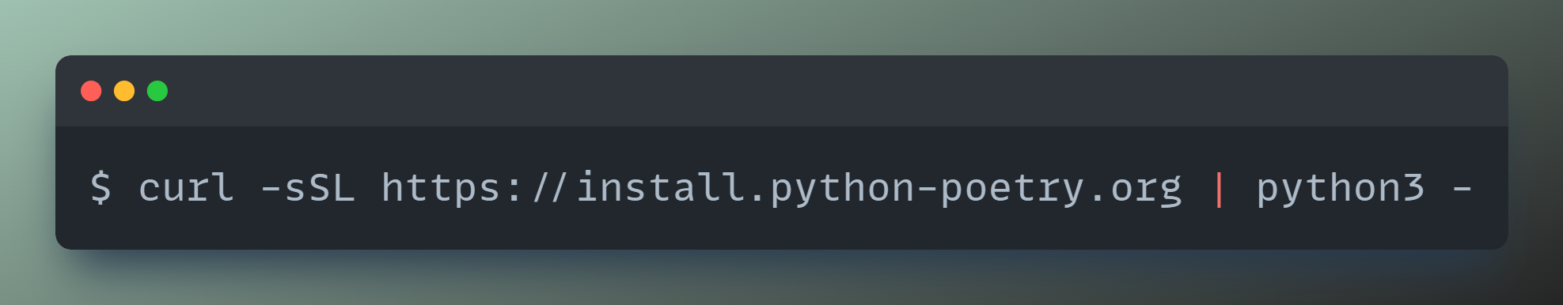
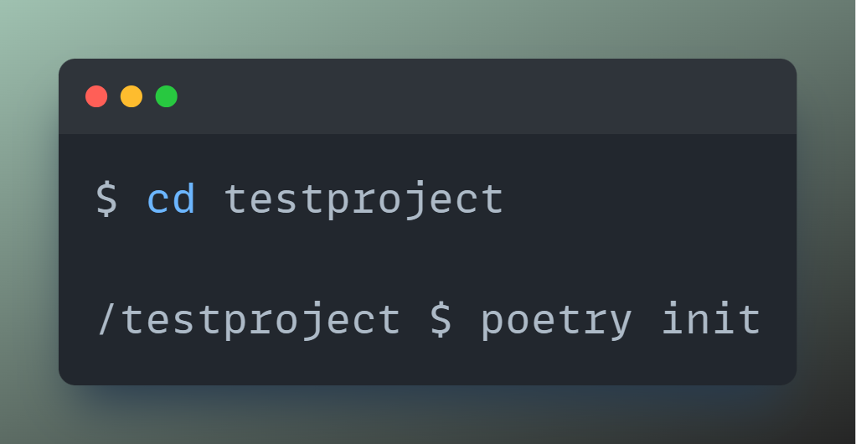
Dependency Management: Poetry
1. Install Poetry
2. Initialize Poetry project
Notes:
Installation: https://python-poetry.org/docs/#installing-with-the-official-installer
→ I recommend using the official installer instead of installing it via pip (or similar). It‘s much more stable in my experience.
Usage: https://python-poetry.org/docs/basic-usage/
Publish Package to PyPI: https://www.freecodecamp.org/news/how-to-build-and-publish-python-packages-with-poetry/

Slide 13
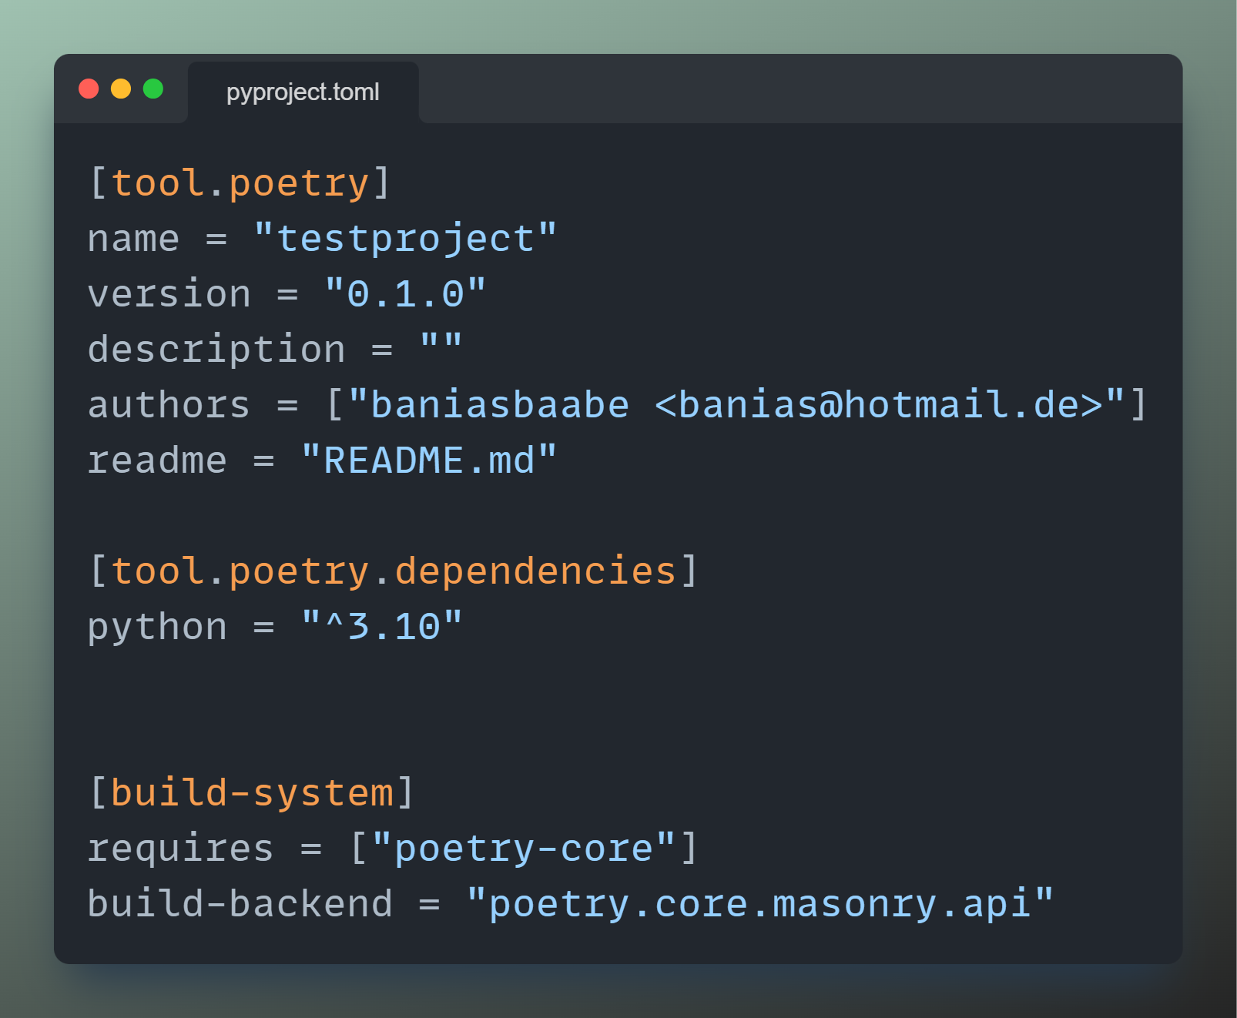
Dependency Management: Poetry
2.1 Resulting pyproject.toml file:
Notes:
Installation: https://python-poetry.org/docs/#installing-with-the-official-installer
→ I recommend using the official installer instead of installing it via pip (or similar). It‘s much more stable in my experience.
Usage: https://python-poetry.org/docs/basic-usage/
Publish Package to PyPI: https://www.freecodecamp.org/news/how-to-build-and-publish-python-packages-with-poetry/

Slide 14
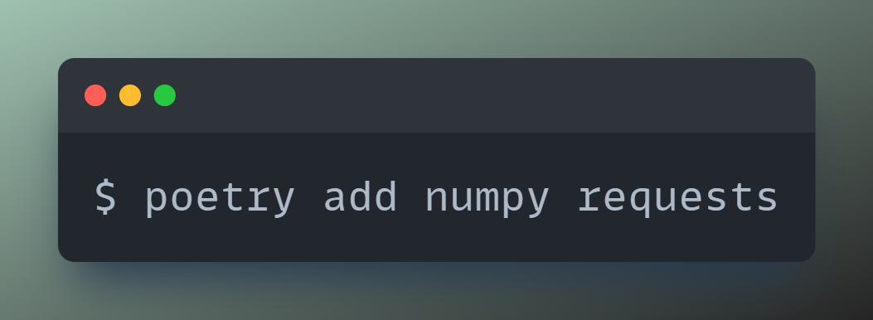
Dependency Management: Poetry
3. Install dependencies
Notes:
Installation: https://python-poetry.org/docs/#installing-with-the-official-installer
→ I recommend using the official installer instead of installing it via pip (or similar). It‘s much more stable in my experience.
Usage: https://python-poetry.org/docs/basic-usage/
Publish Package to PyPI: https://www.freecodecamp.org/news/how-to-build-and-publish-python-packages-with-poetry/

Slide 15
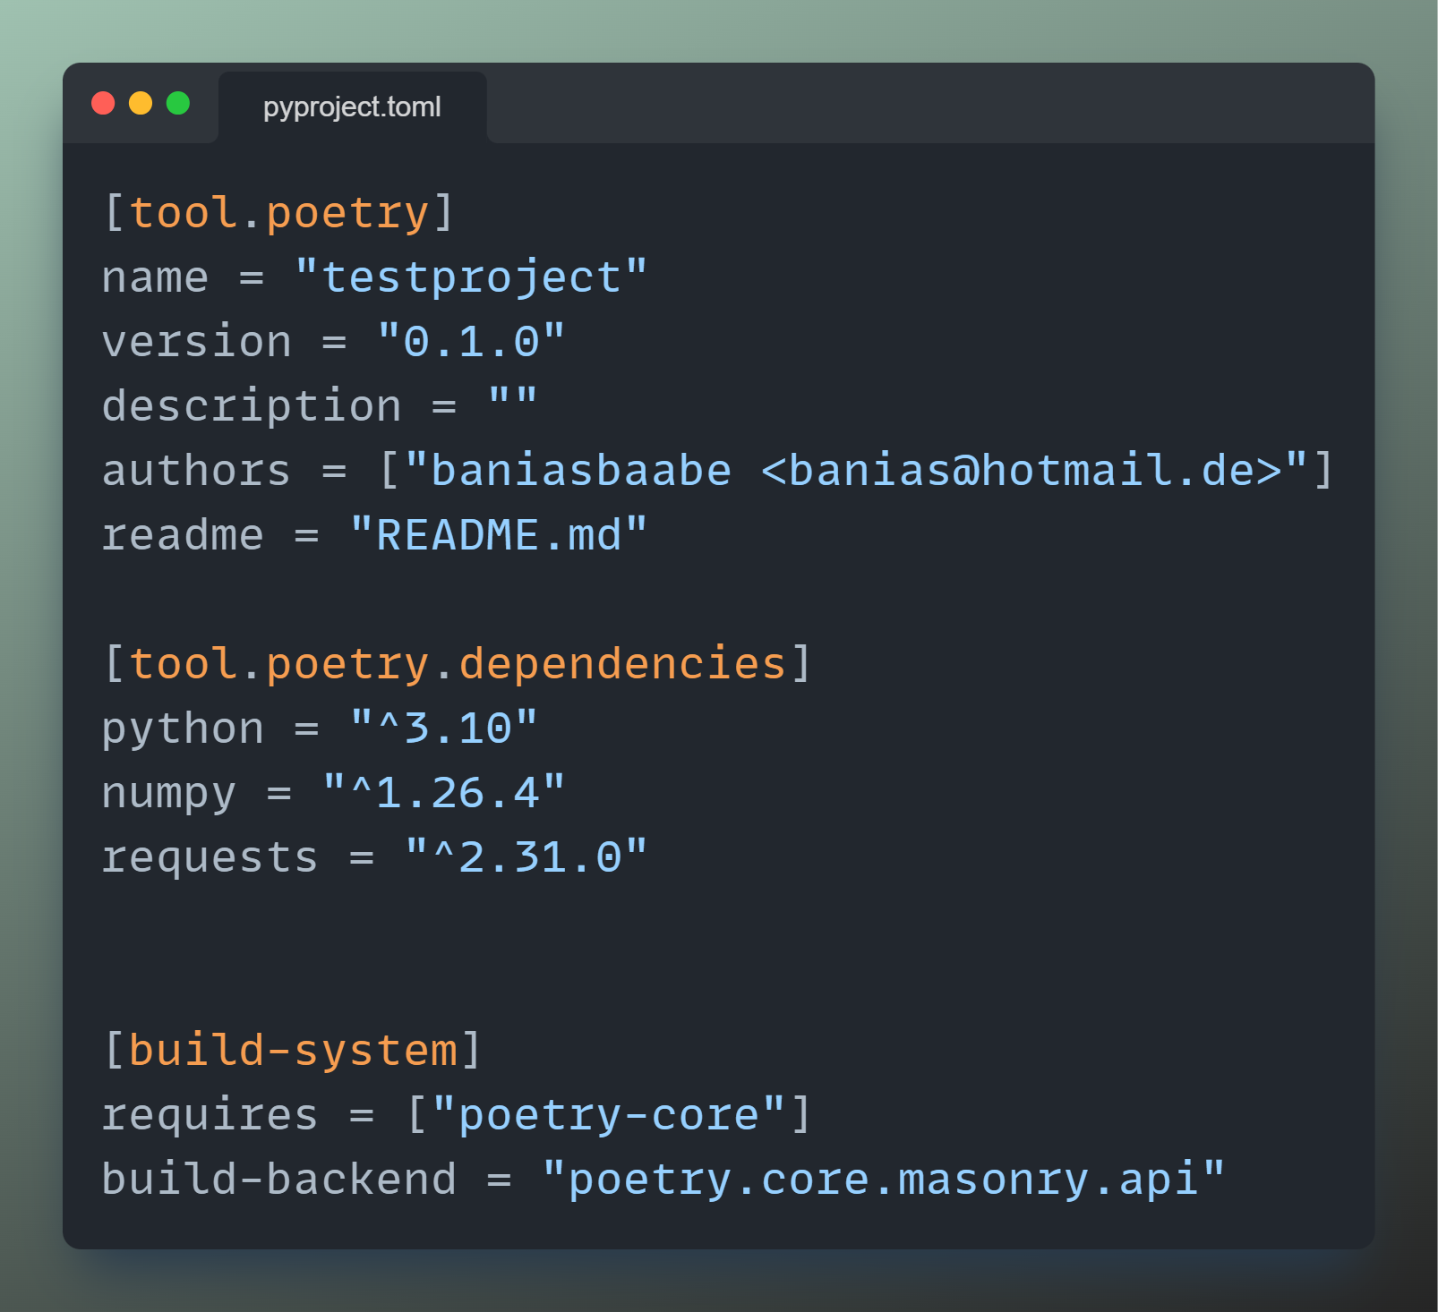
Dependency Management: Poetry
3.1 Resulting pyproject.toml file:
3.2 Resulting poetry.lock file:
Too long to show ☺
Notes:
Installation: https://python-poetry.org/docs/#installing-with-the-official-installer
→ I recommend using the official installer instead of installing it via pip (or similar). It‘s much more stable in my experience.
Usage: https://python-poetry.org/docs/basic-usage/
Publish Package to PyPI: https://www.freecodecamp.org/news/how-to-build-and-publish-python-packages-with-poetry/

Slide 16
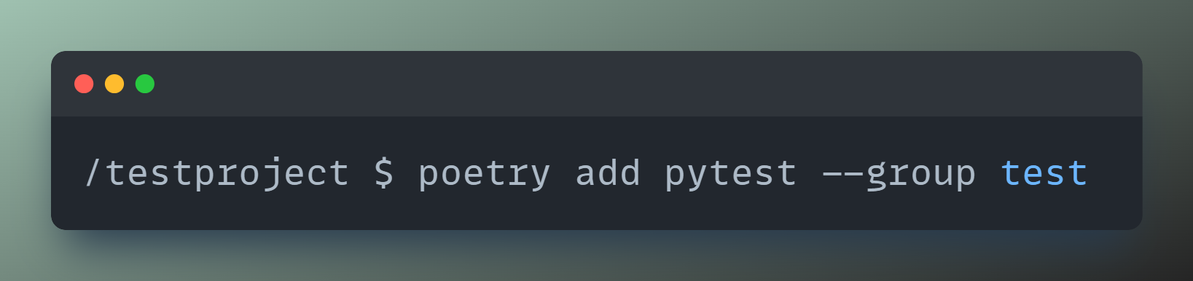
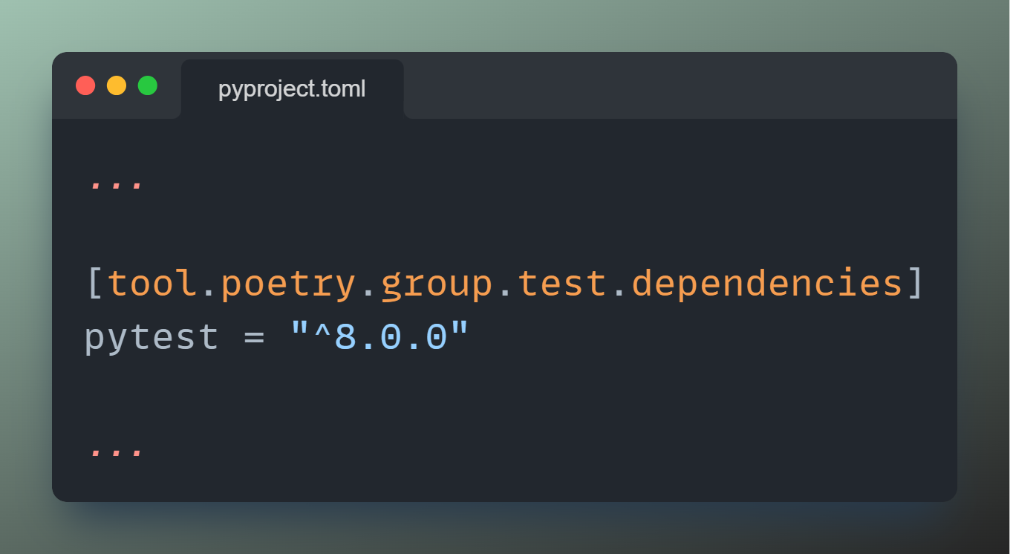
Dependency Management: Poetry
4. Create groups
4.1 Resulting pyproject.toml file
Notes:
Installation: https://python-poetry.org/docs/#installing-with-the-official-installer
→ I recommend using the official installer instead of installing it via pip (or similar). It‘s much more stable in my experience.
Usage: https://python-poetry.org/docs/basic-usage/
Publish Package to PyPI: https://www.freecodecamp.org/news/how-to-build-and-publish-python-packages-with-poetry/

Slide 17
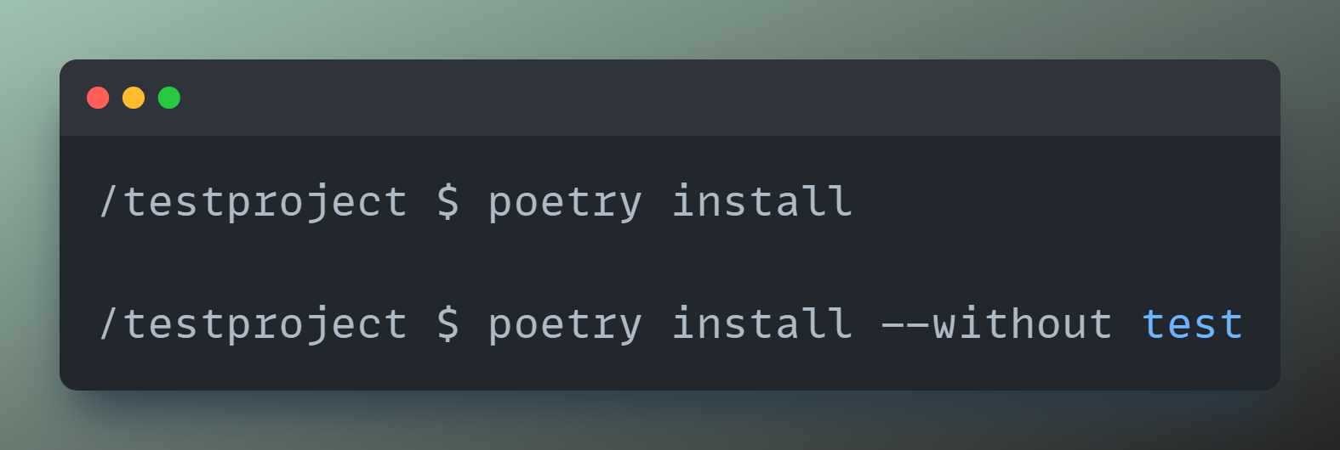
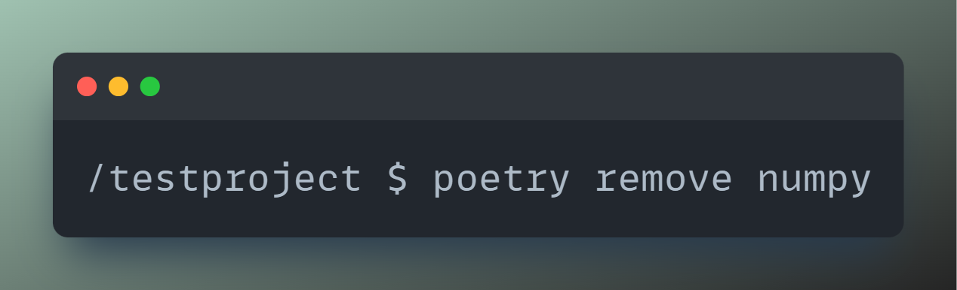
Dependency Management: Poetry
5. Install with/without group
6. Remove dependency
Notes:
Installation: https://python-poetry.org/docs/#installing-with-the-official-installer
→ I recommend using the official installer instead of installing it via pip (or similar). It‘s much more stable in my experience.
Usage: https://python-poetry.org/docs/basic-usage/
Publish Package to PyPI: https://www.freecodecamp.org/news/how-to-build-and-publish-python-packages-with-poetry/

Slide 18
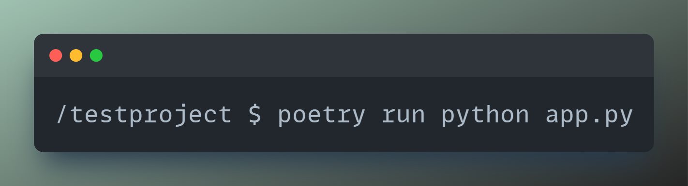
Dependency Management: Poetry
7. Run Python script
Notes:
Installation: https://python-poetry.org/docs/#installing-with-the-official-installer
→ I recommend using the official installer instead of installing it via pip (or similar). It‘s much more stable in my experience.
Usage: https://python-poetry.org/docs/basic-usage/
Publish Package to PyPI: https://www.freecodecamp.org/news/how-to-build-and-publish-python-packages-with-poetry/

Slide 19

Linting: Ruff
Notes:
Documentation: https://docs.astral.sh/ruff/linter/
Configuration: https://docs.astral.sh/ruff/configuration/
Rules: https://docs.astral.sh/ruff/rules/

Slide 20
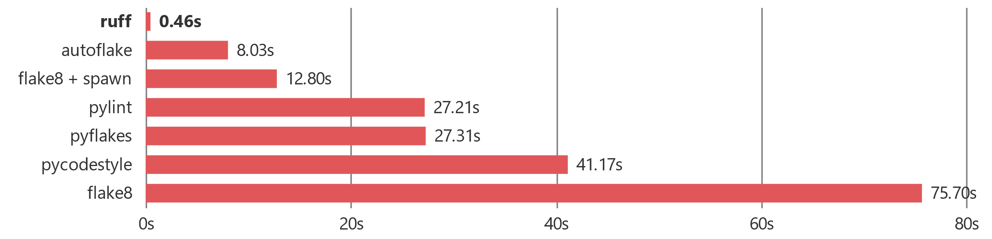
Linting: Ruff
Written in Rust → Super-fast
Over 700 built-in rules
Can format your code too (see later)
Notes:
Documentation: https://docs.astral.sh/ruff/linter/
Configuration: https://docs.astral.sh/ruff/configuration/
Rules: https://docs.astral.sh/ruff/rules/

Slide 21
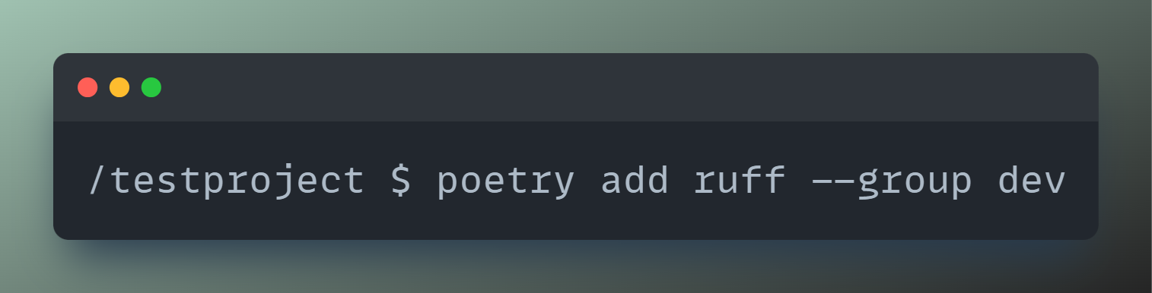
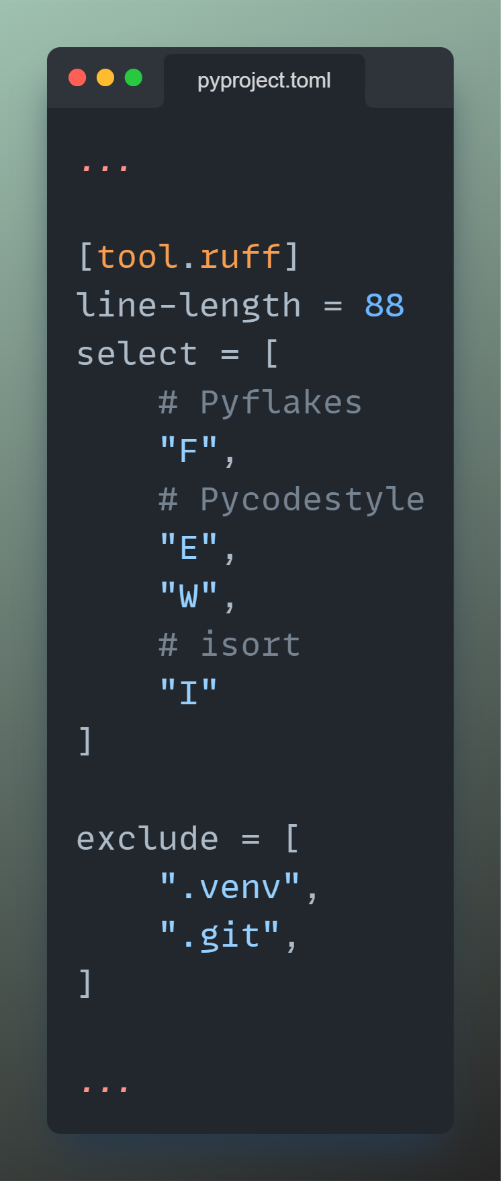
Linting: Ruff
1. Install ruff
2. Configure ruff
Notes:
Documentation: https://docs.astral.sh/ruff/linter/
Configuration: https://docs.astral.sh/ruff/configuration/
Rules: https://docs.astral.sh/ruff/rules/

Slide 22
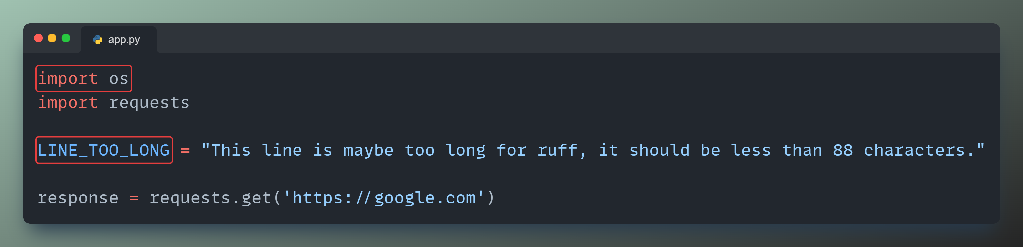
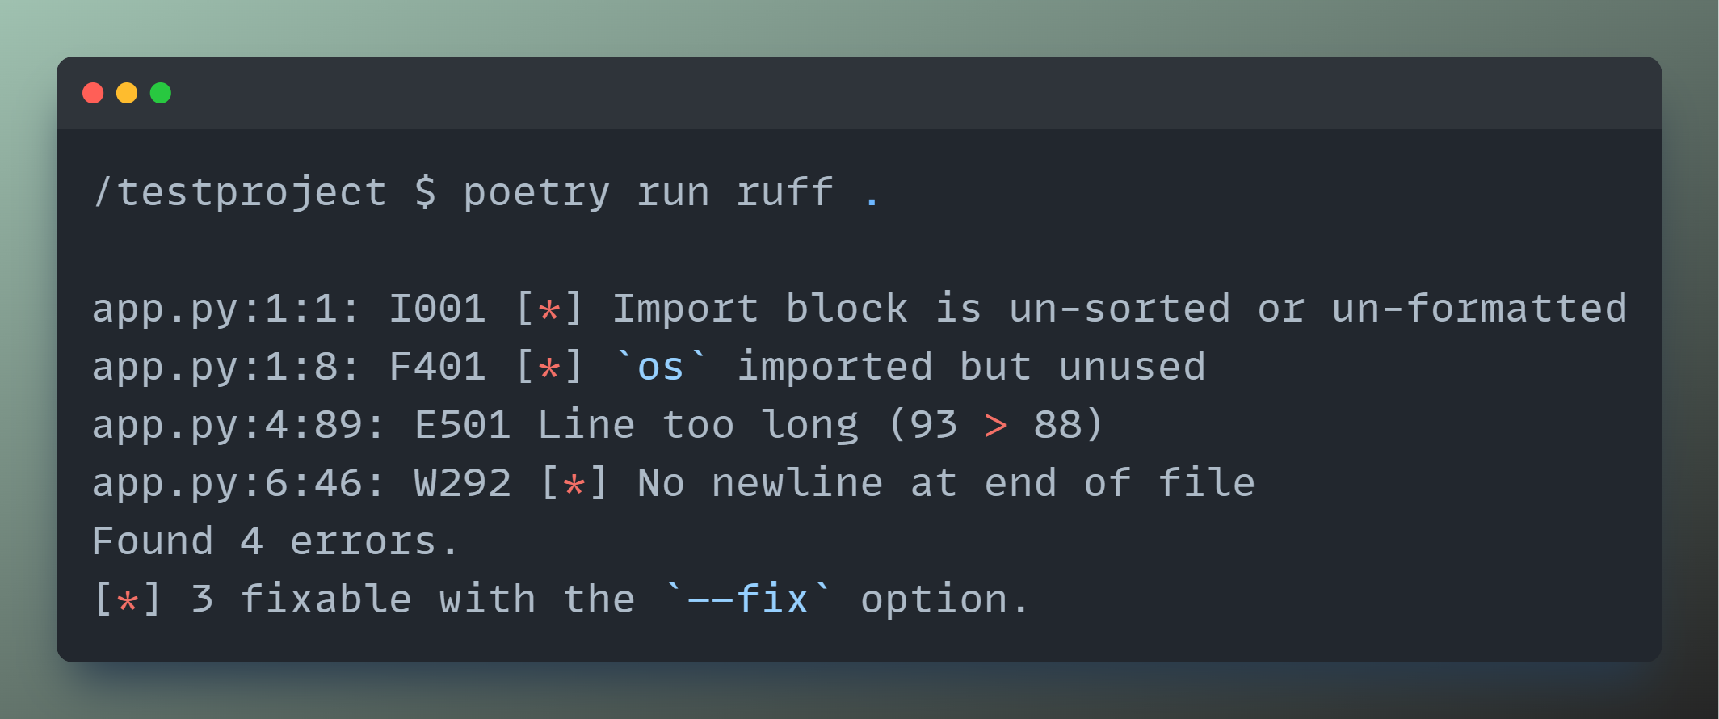
Linting: Ruff
3. Run ruff
Notes:
Documentation: https://docs.astral.sh/ruff/linter/
Configuration: https://docs.astral.sh/ruff/configuration/
Rules: https://docs.astral.sh/ruff/rules/

Slide 23
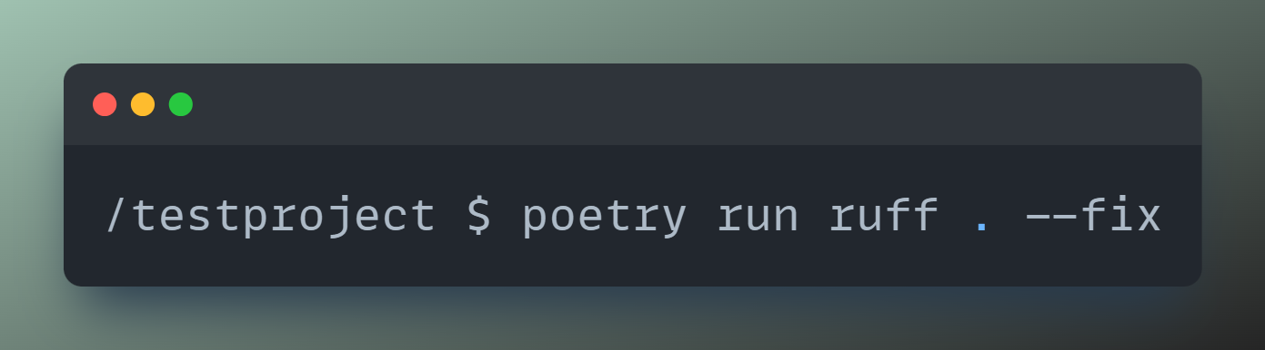
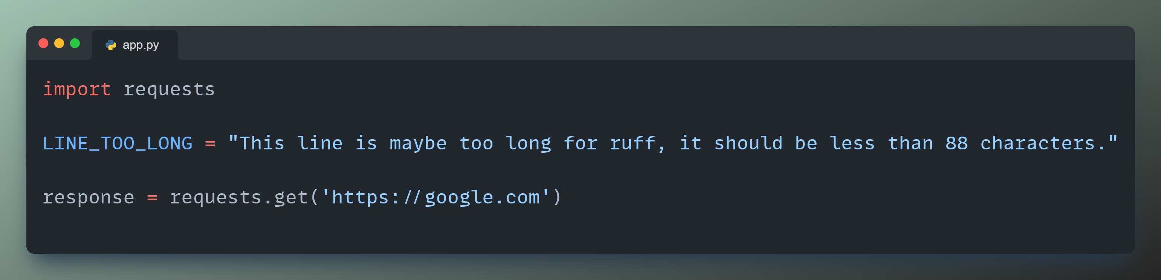
Linting: Ruff
4. Run ruff and fix errors
Notes:
Documentation: https://docs.astral.sh/ruff/linter/
Configuration: https://docs.astral.sh/ruff/configuration/
Rules: https://docs.astral.sh/ruff/rules/

Slide 24
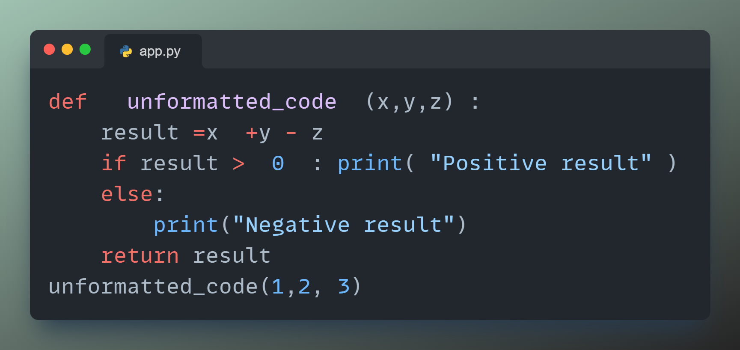
Formatting: Ruff
Notes:
Documentation: https://docs.astral.sh/ruff/formatter/

Slide 25
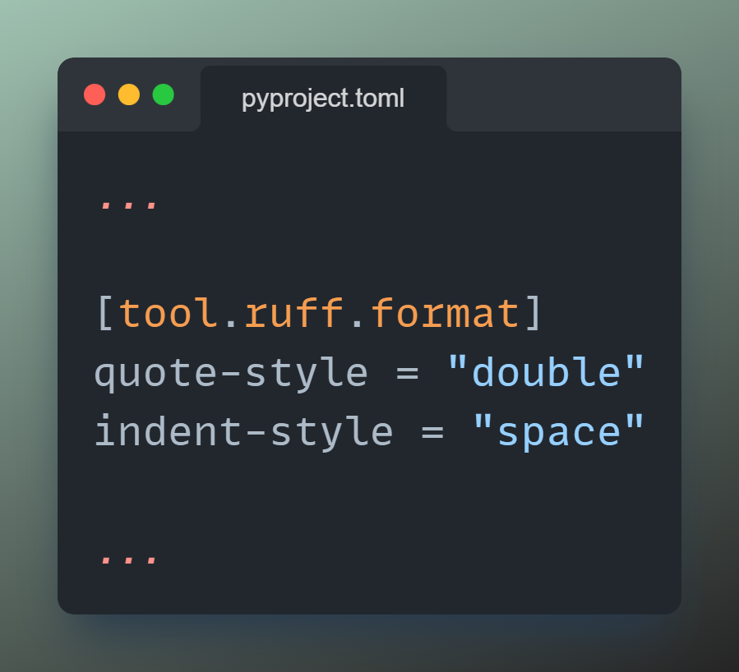
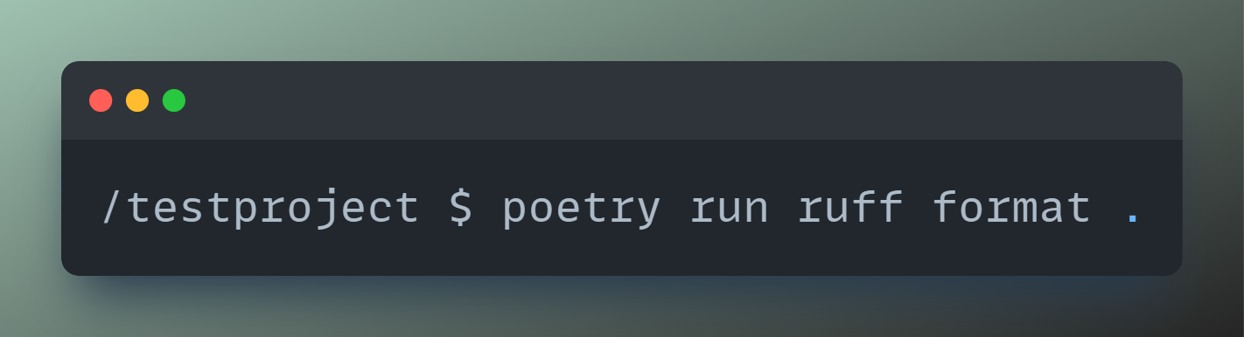
Formatting: Ruff
1. Configure ruff
2. Run ruff
Notes:
Documentation: https://docs.astral.sh/ruff/formatter/

Slide 26
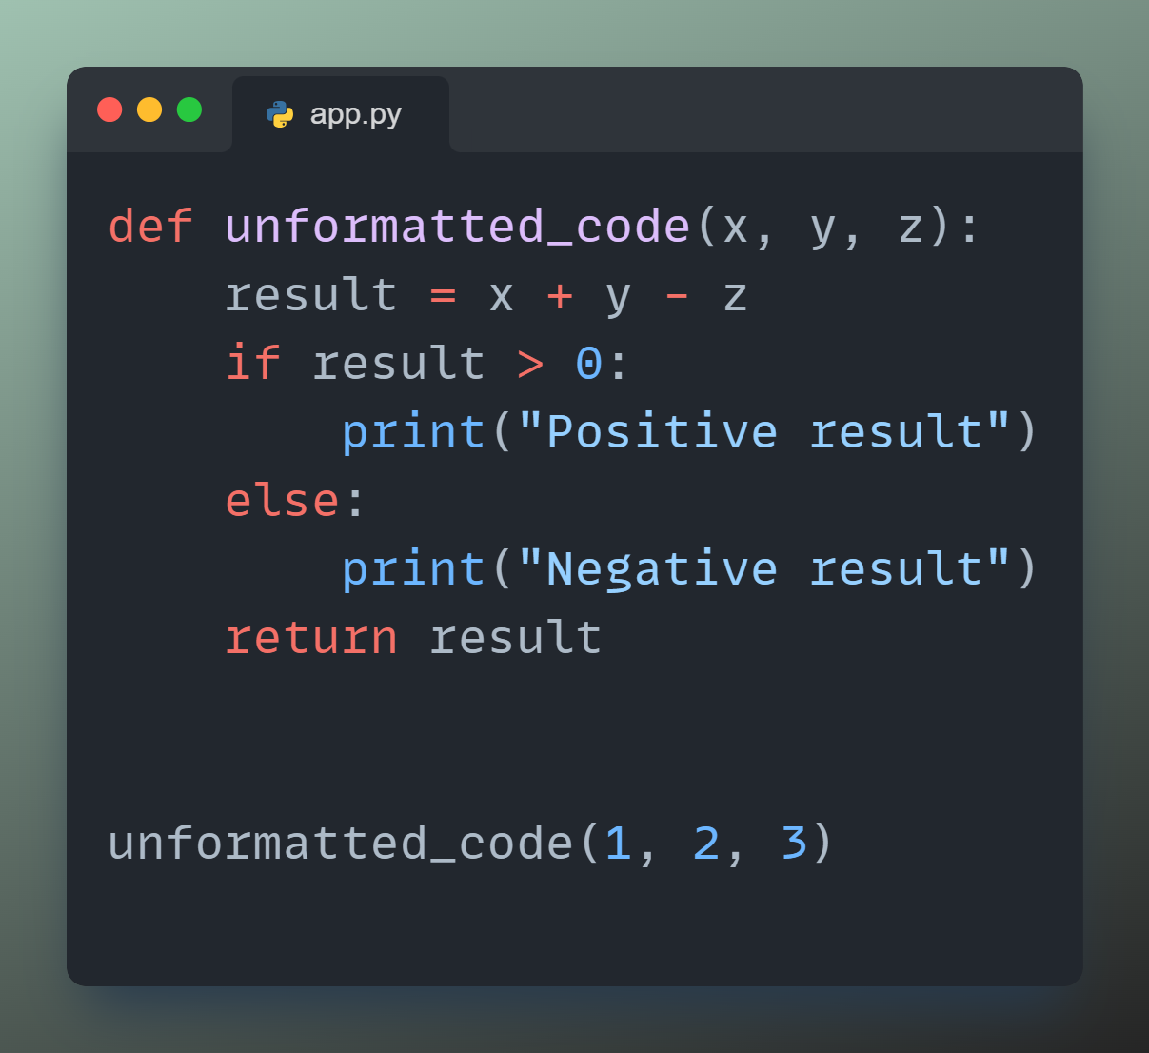
Formatting: Ruff
2.1 Resulting Python file
Notes:
Documentation: https://docs.astral.sh/ruff/formatter/

Slide 27
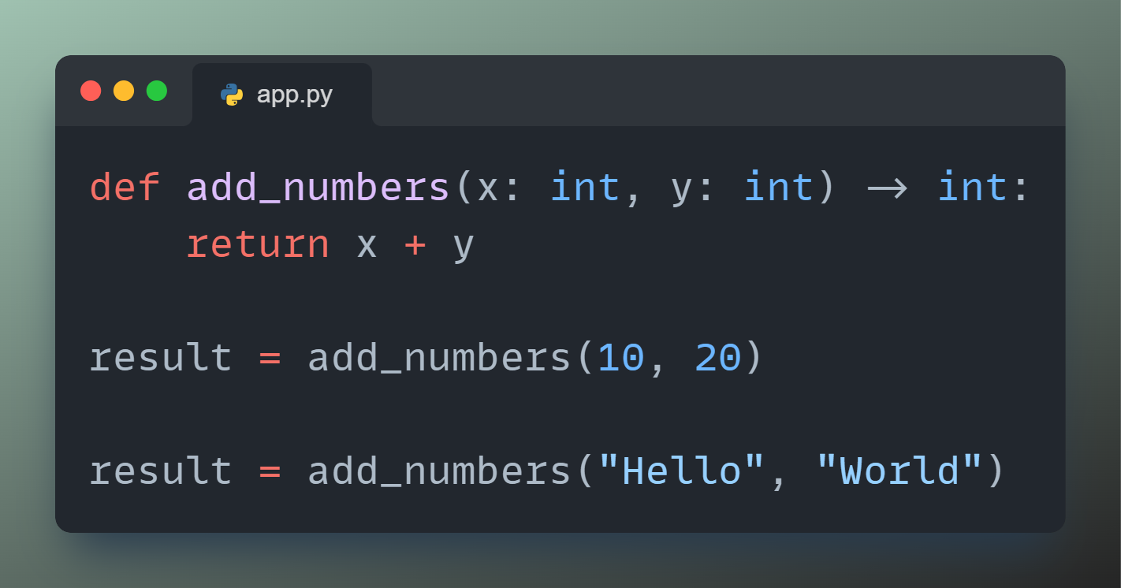
Type checking: mypy
Notes:
Documentation: https://mypy-lang.org

Slide 28

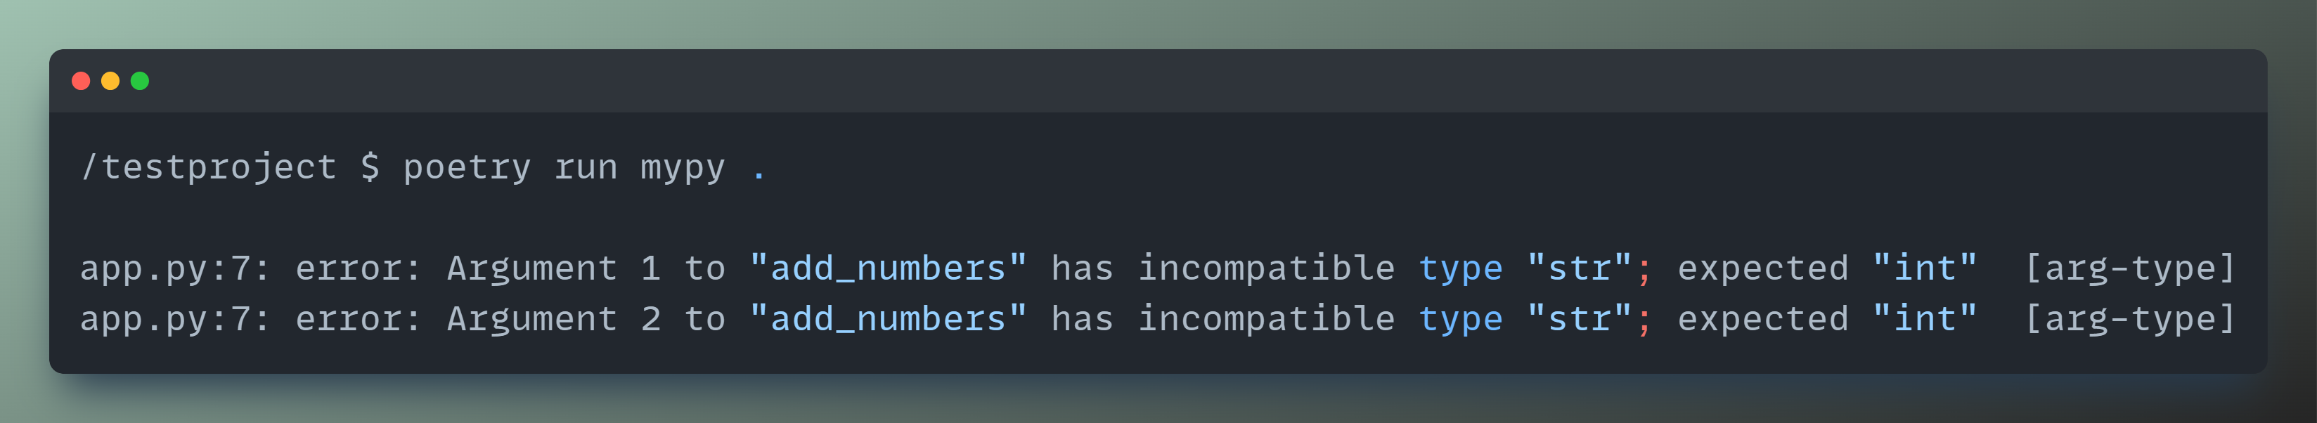
Type checking: mypy
1. Install mypy
2. Run mypy
Notes:
Documentation: https://mypy-lang.org

Slide 29

Documentation: pdoc
Notes:
Documentation: https://pdoc.dev/docs/pdoc.html

Slide 30
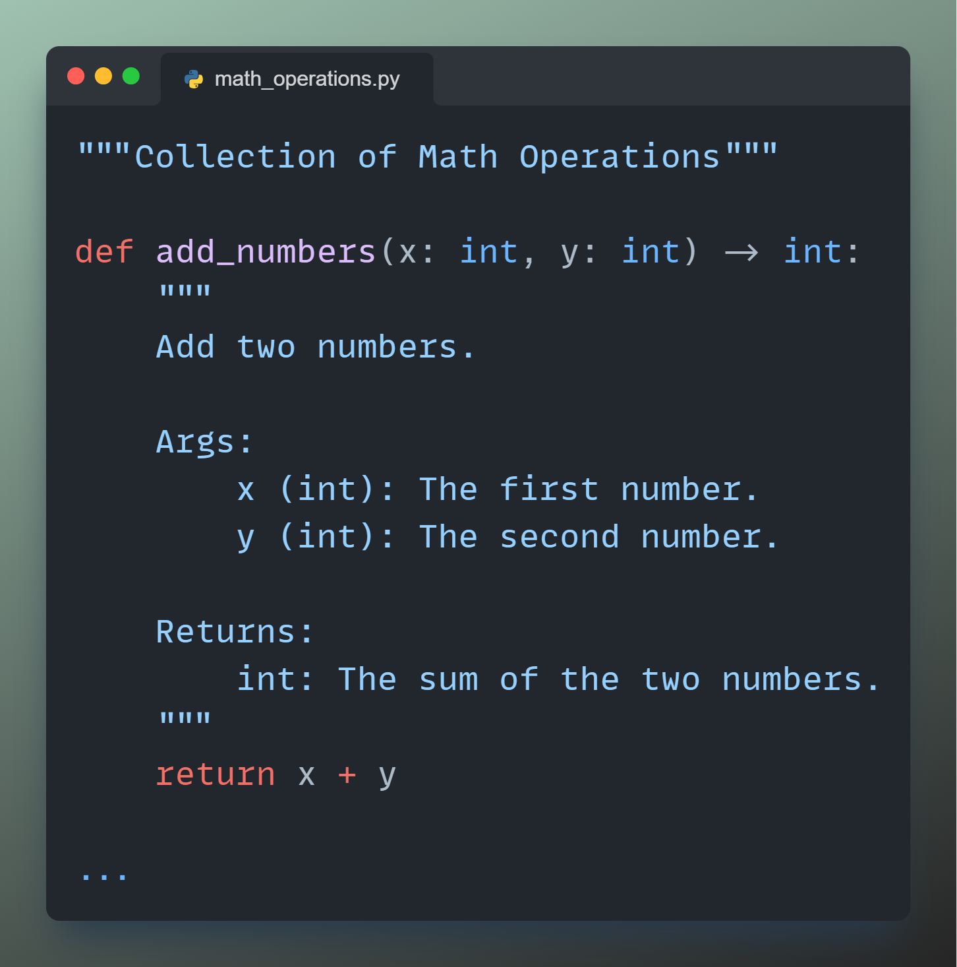
Documentation: pdoc
Notes:
Documentation: https://pdoc.dev/docs/pdoc.html

Slide 31
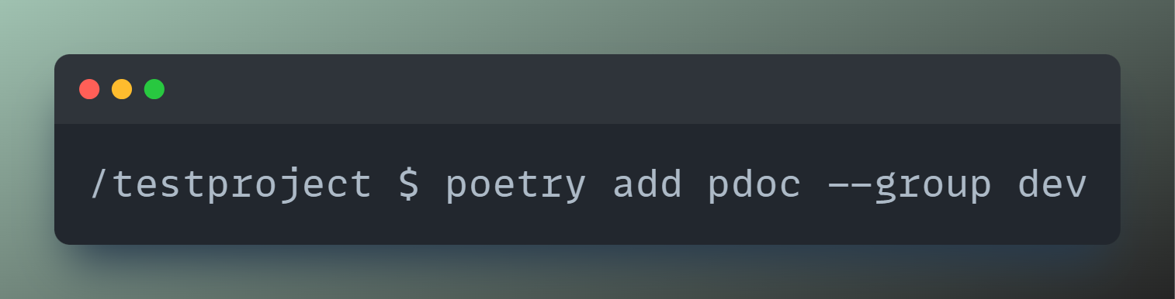
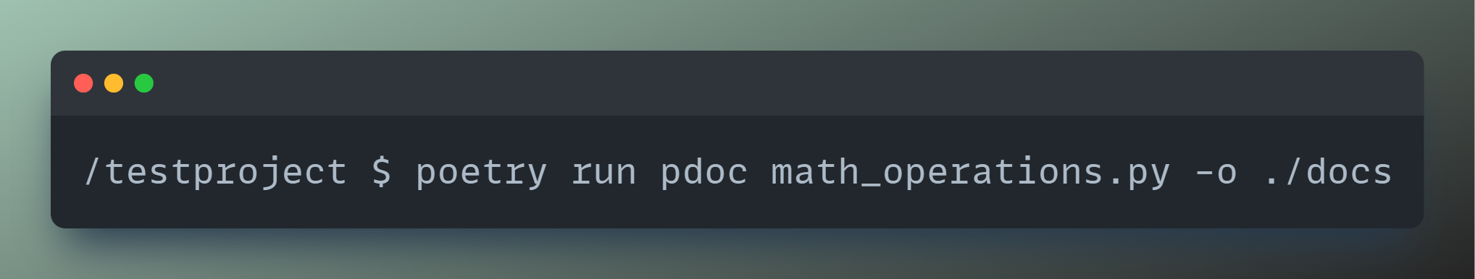
Documentation: pdoc
1. Install pdoc
2. Run pdoc
Notes:
Documentation: https://pdoc.dev/docs/pdoc.html

Slide 32
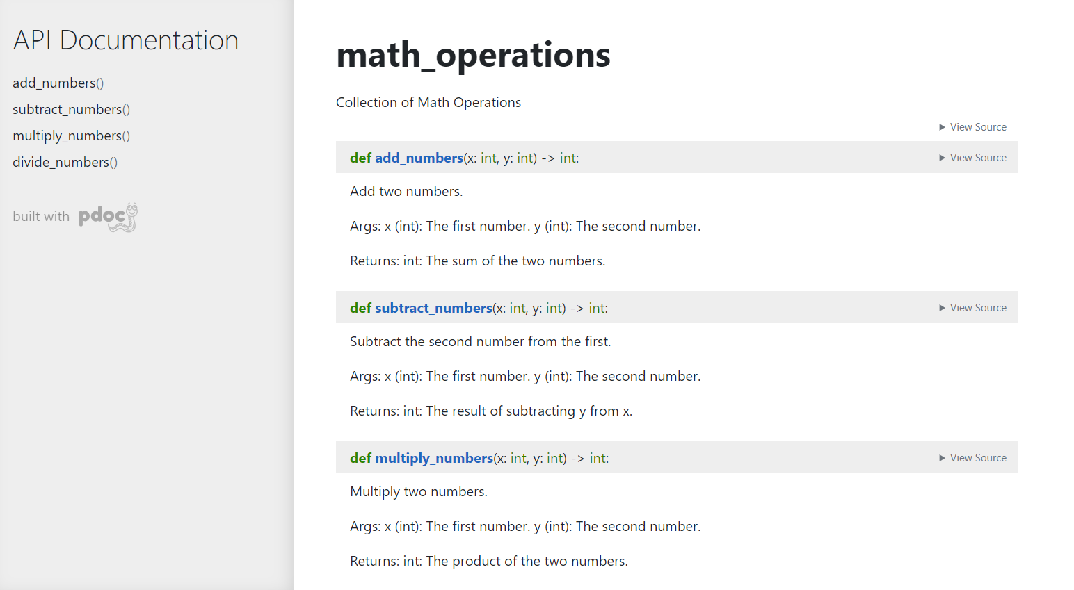
Documentation: pdoc
Notes:
Documentation: https://pdoc.dev/docs/pdoc.html

Slide 33
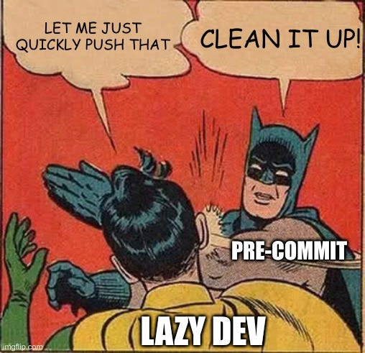
Automation: pre-commit
Notes:
Documentation: https://pre-commit.com
List of all pre-commit hooks: https://pre-commit.com/hooks.html
Write your own pre-commit hook: https://dev.to/jalvaradosegura/create-your-own-pre-commit-hook-3kh

Slide 34
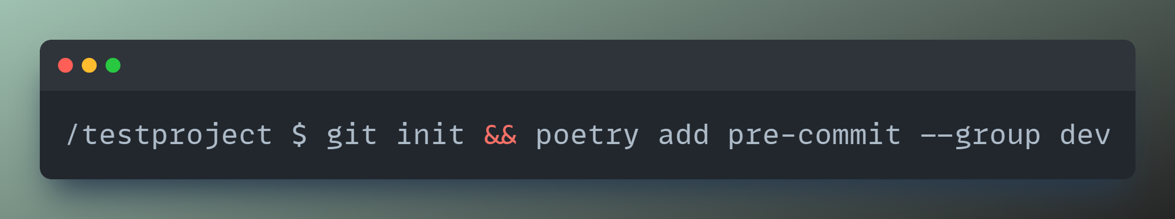
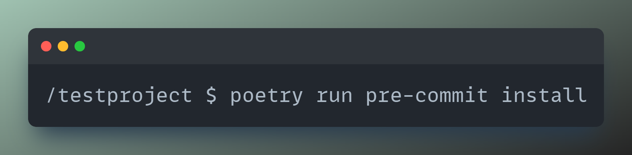
Automation: pre-commit
1. Install pre-commit
2. Set up git hook scripts
Notes:
Documentation: https://pre-commit.com
List of all pre-commit hooks: https://pre-commit.com/hooks.html
Write your own pre-commit hook: https://dev.to/jalvaradosegura/create-your-own-pre-commit-hook-3kh

Slide 35
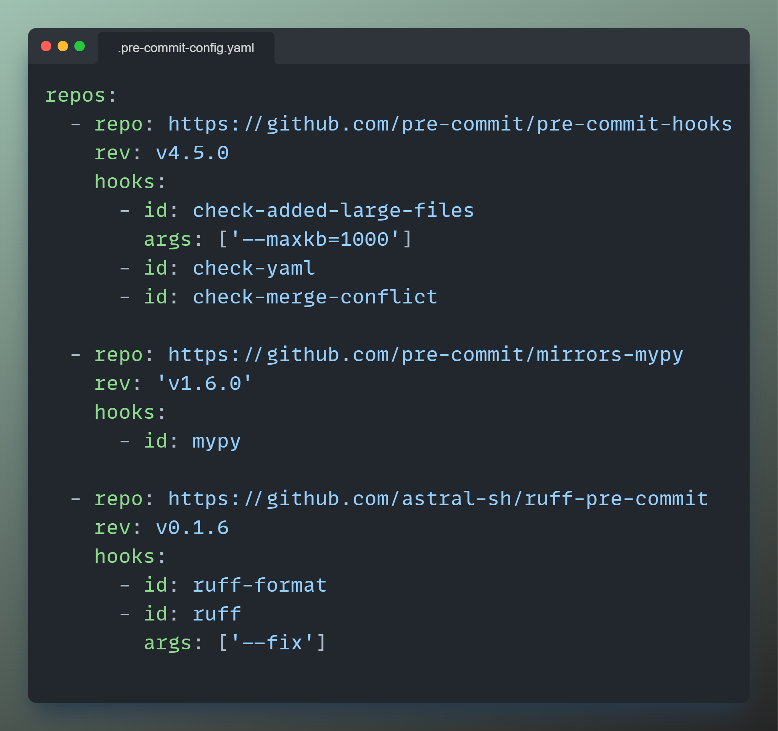
Automation: pre-commit
3. Define YAML file
Notes:
Documentation: https://pre-commit.com
List of all pre-commit hooks: https://pre-commit.com/hooks.html
Write your own pre-commit hook: https://dev.to/jalvaradosegura/create-your-own-pre-commit-hook-3kh

Slide 36
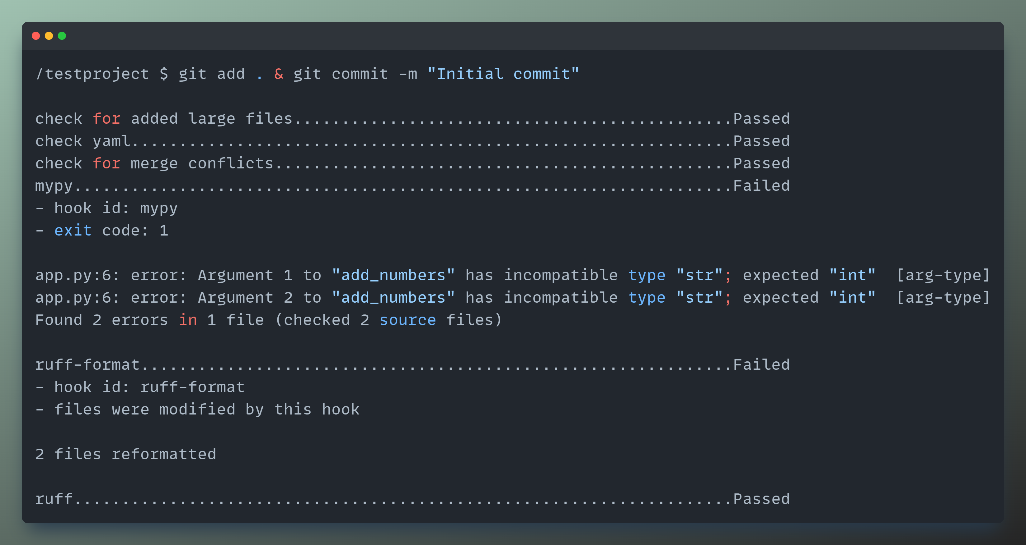
Automation: pre-commit
4. Git add & commit
Notes:
Documentation: https://pre-commit.com
List of all pre-commit hooks: https://pre-commit.com/hooks.html
Write your own pre-commit hook: https://dev.to/jalvaradosegura/create-your-own-pre-commit-hook-3kh

Slide 37

Automation: make & Makefile
Notes:
More information about make & Makefile: https://earthly.dev/blog/python-makefile/
Make for Windows: https://gnuwin32.sourceforge.net/packages/make.htm

Slide 38
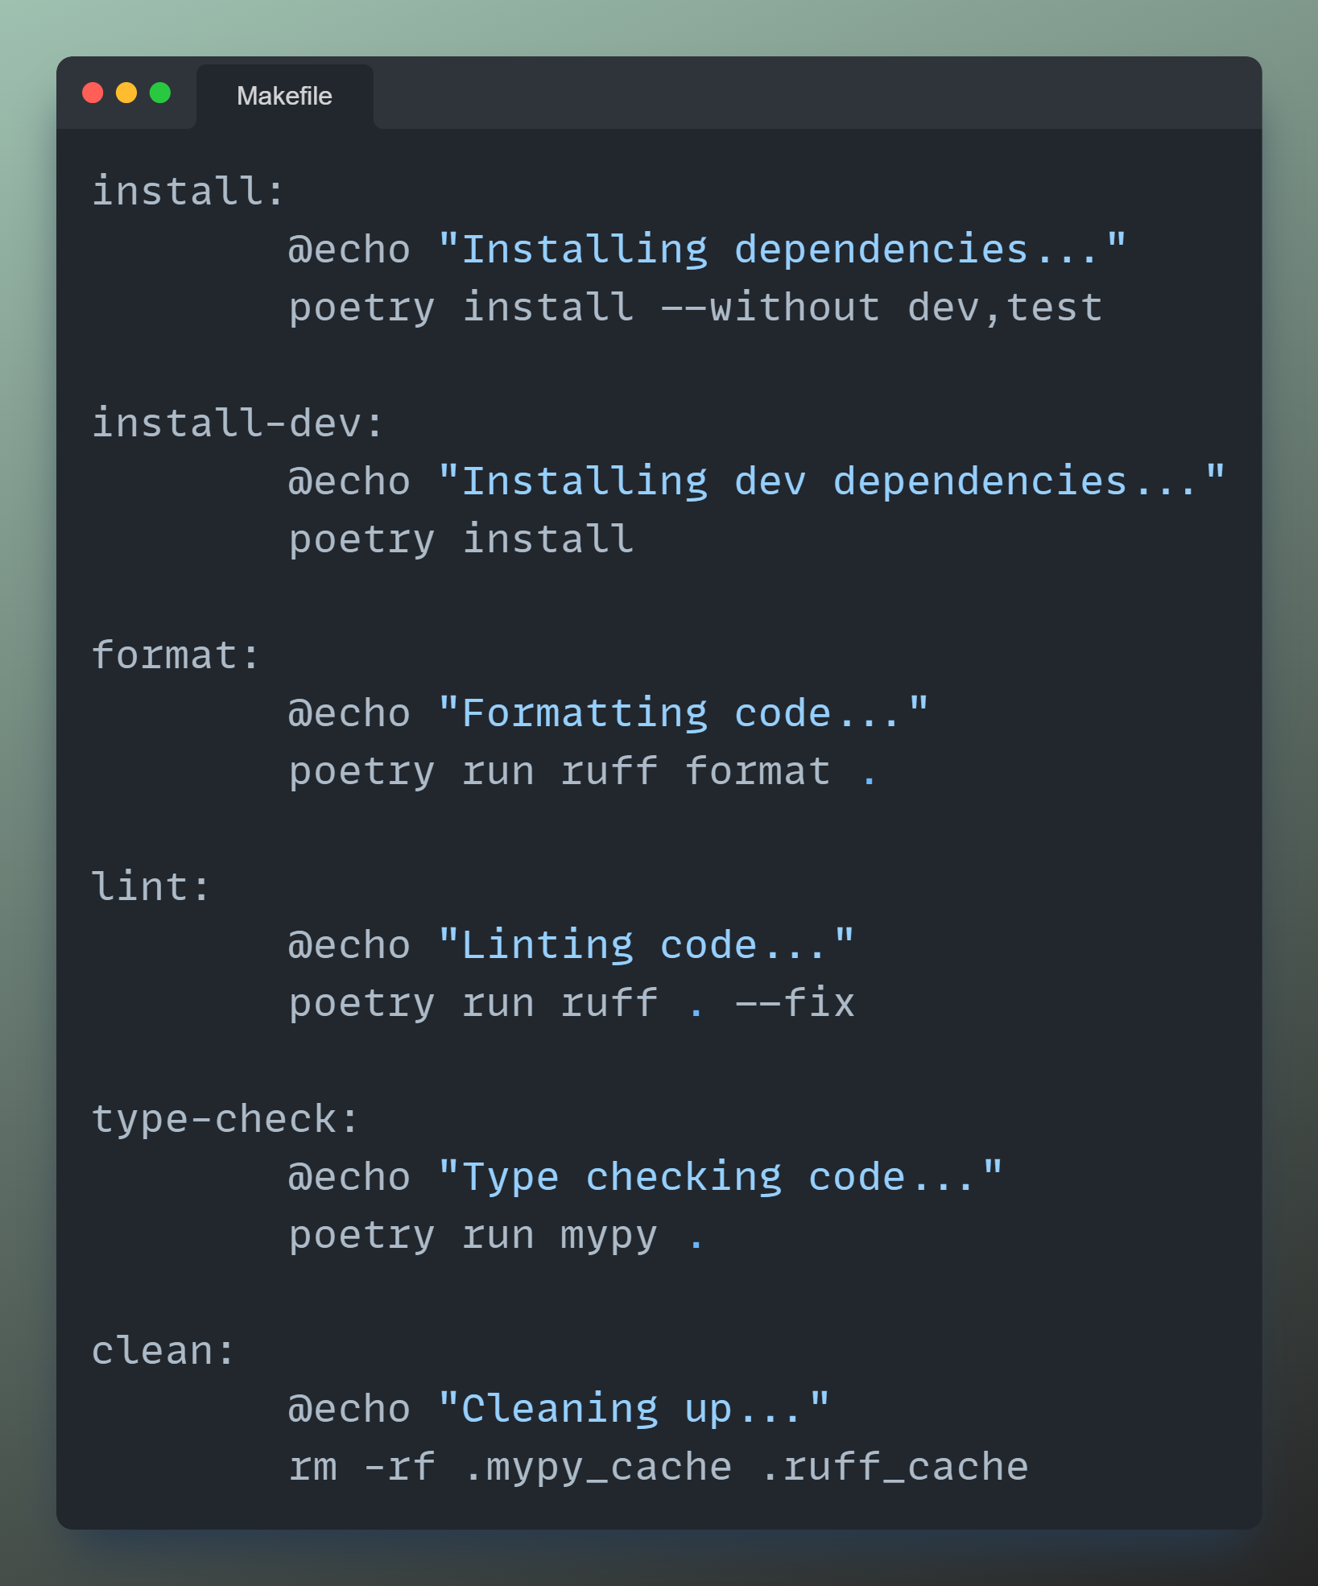
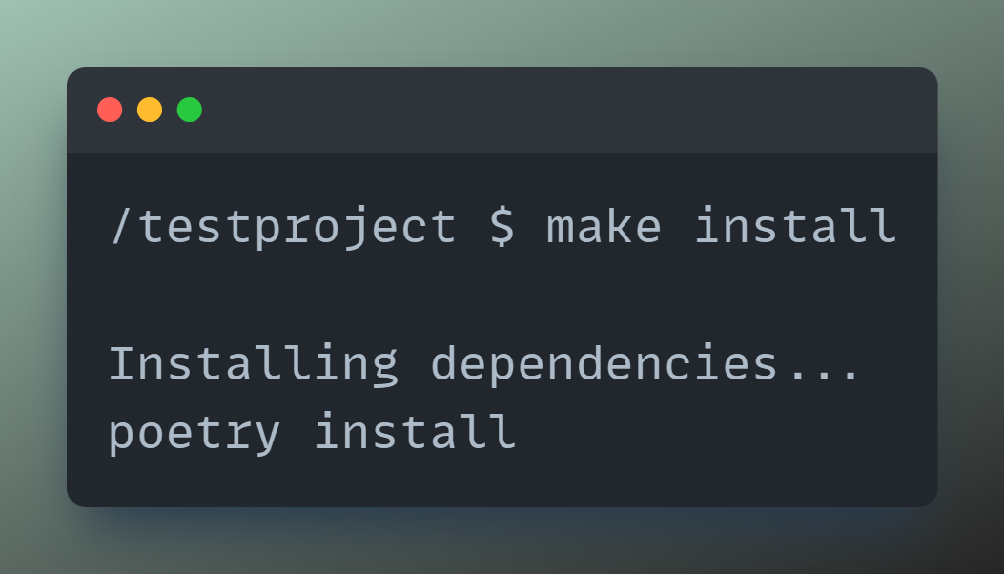
Automation: make & Makefile
1. Define targets
2. Run
Notes:
More information about make & Makefile: https://earthly.dev/blog/python-makefile/
Make for Windows: https://gnuwin32.sourceforge.net/packages/make.htm

Slide 39
Conclusion
Focus on the basics
No „false productivity“
Tools don‘t turn you into a 10x developer

